Slide 1

IMDb Data Insights: Top-Grossing Movies & Studio Financials
Mohit Bisen

Slide 2

Project Overview
Objective: To analyze IMDb data to identify top-grossing movies and evaluate the financial performance of various studios through comprehensive profit & loss statements.
Tools Used: Microsoft Excel (Power Query, Power Pivot, Pivot Tables)
A

Slide 3

Data Source and Collection
Data Source: IMDb database
Movies (movie id, title, industry, release year, imdb rating, studio, language id)
Financials (movie id, budgets, revenue, unit, currency)
Target (studio, target)
Actors (actor id, name, birth year)
Movie Actor (movie id, actor id)
Languages (language id, name)
Data Collection Methods:
Imported data into Excel using Power Query

Slide 4

Data transformation with Power Query
Purpose: Clean and prepare raw data for analysis
Processes:
Removed duplicates and irrelevant columns
Standardized data formats (e.g., unit, currency)
Merged multiple datasets (Movies and Financials)
Outcome: A clean, structured dataset ready for modeling
4

Slide 5
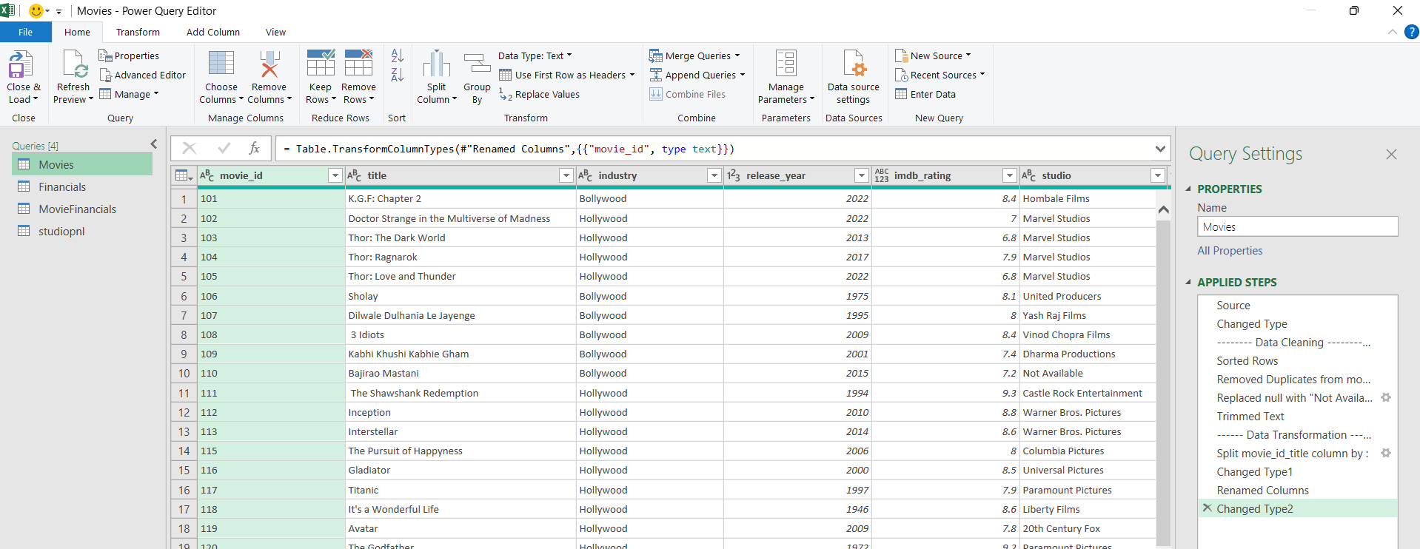
Data Cleaning

Slide 6
Data Modeling with Power Pivot
Purpose: Create a robust data model to handle complex calculations and relationships
Steps:
Established relationships between different tables (Movies, Financials)
Added calculated columns and measures (e.g., Target, Profit & Loss, Profit & Loss %, Actual - Target, Actual – Target %)
Ensured data integrity and accuracy

Slide 7

Data Modeling

Slide 8
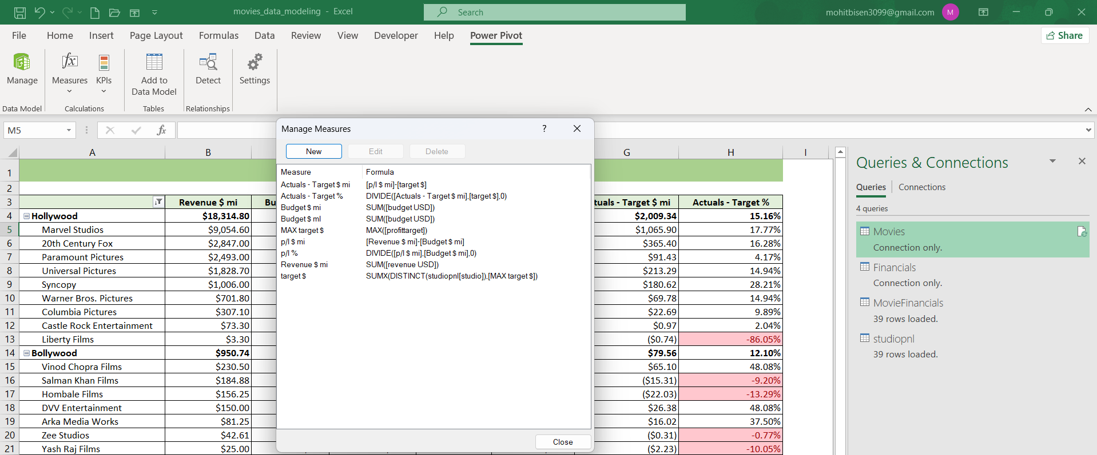
Create Measures in Power Pivot

Slide 9
Data Analysis with Pivot Tables
Purpose: Generate insightful reports and visualizations
Analyses Conducted:
Top-Grossing Movies:
Identified highest-grossing movies by Industry and Studio
Analyzed revenue, budget and profit
Studio Financial Performance:
Created profit & loss statements for studios
Assessed financial health and profitability metrics
Tools: Used Pivot Tables to summarize and visualize data
9

Slide 10
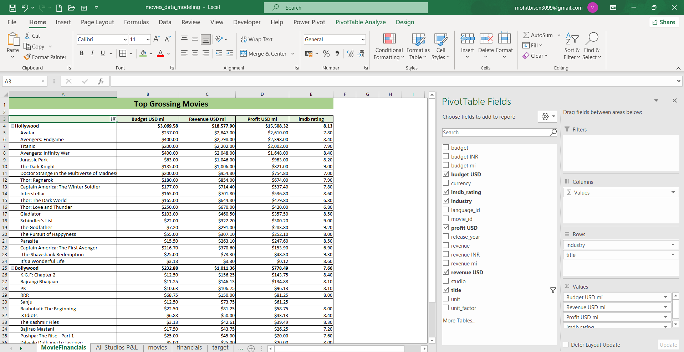
Top Grossing Movies

Slide 11
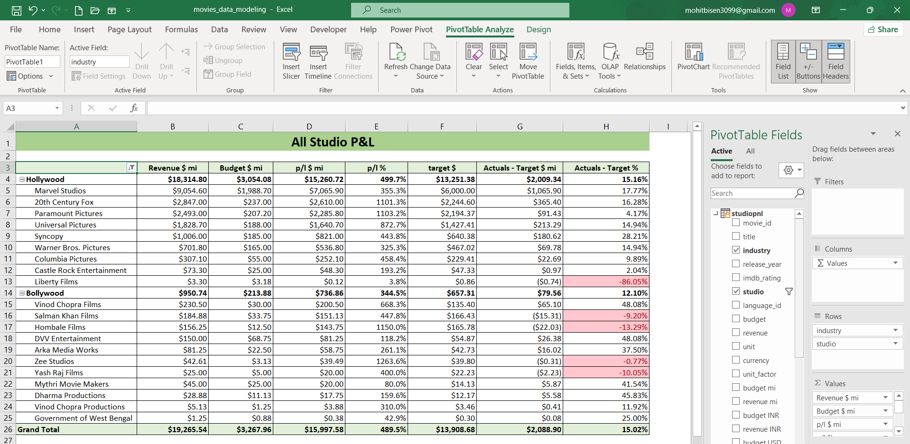
All Studio Profit & Loss Statement

Slide 12
Key Findings
Top-Grossing Movies:
Avatar is the most successful movie by revenue and Profit in Hollywood in year 2009
KGF Chapter 2 is the most successful movie by revenue and profit in Bollywood in year 2022
Studio Financials:
Profit & loss summaries showing profitable and non-profitable studios
Marvel Studio is the most profitable studio in Hollywood
Vinod Chopra Films is the most profitable studio in Bollywood

Slide 13

Thank You
Mohit Bisen
8830271875
mohitbisen3099@gmail.com
LinkedIn

